Slide 1

CUSTOMER CHURN PREDICTION
Aatish Kayyath
MS in Machine Learning Department of Computer Science Jersey City, USA akayyath@stevens,edu
Aston Glen Noronha
MS in Data Science Department of Mathematics Jersey City, USA anoronha@stevens.edu
Rohith Sure
MS in Data Science Department of Mathematics Jersey City, USA rsure@stevens.edu
CPE – 695 – GROUP 3

Slide 2
BACKGROUND
Telecom churn prediction is the process of predicting customer attrition or customer churn in the telecommunications industry. Customer churn is a critical issue for the telecom industry because it is expensive to acquire new customers than to retain existing ones.
Therefore, it is important to be able to identify customers who are likely to churn and take proactive measures to keep them. Machine learning (ML) algorithms can be used to build churn prediction models.
ML algorithms can be used to create models based on customer attributes such as demographics, usage patterns and past behaviours. These models can then be used to accurately predict customer churn.
OBJECTIVE
The objective is to predict with high accuracy if a customer will churn the service provider.
To build a classification system to predict whether a customer will churn or not based on the IBM Telecom Data from Kaggle.
The classifier will be built using bagging algorithms like Random Forest, Logistic Regression, KNN and boosting algorithms like ADABoost, XGBoost.

Slide 3
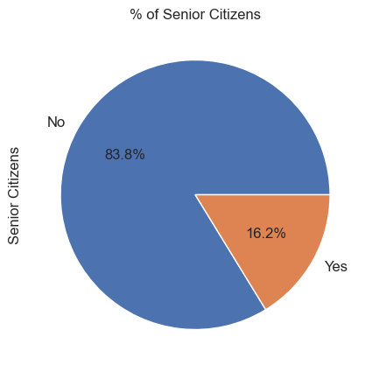
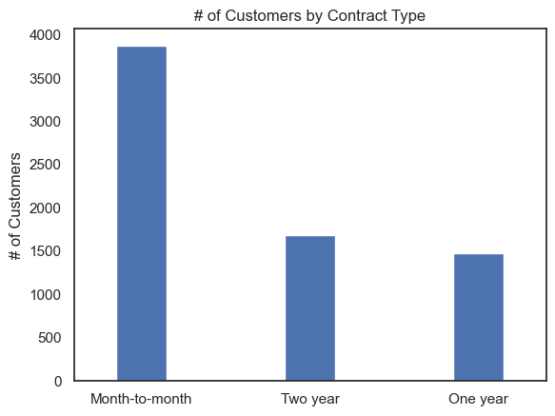
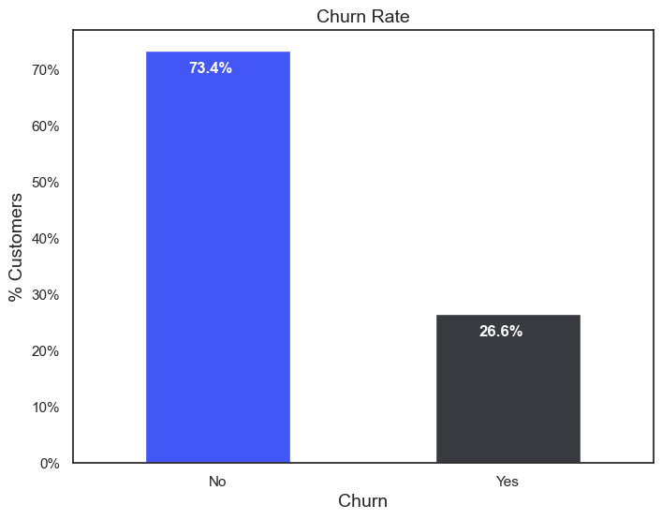
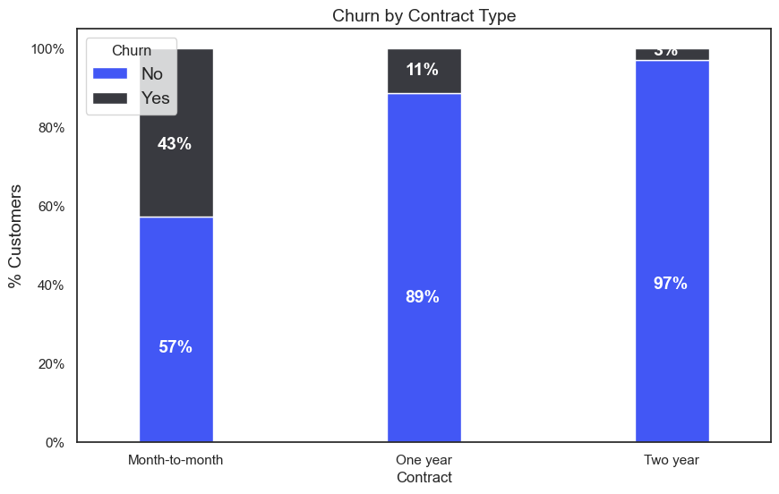
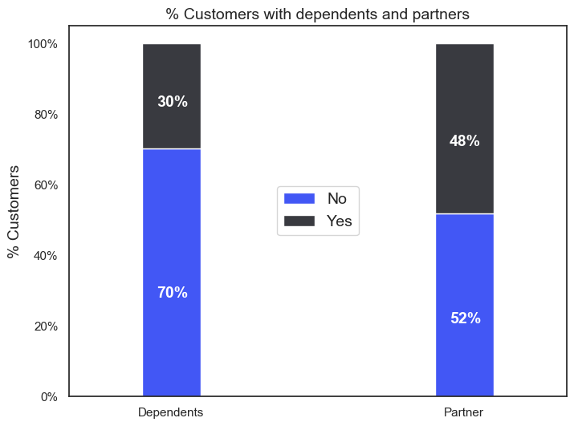
EDA – Exploratory Data Analysis
Customer segmentation by age
Customer segmentation by Contract Type
Customer segmentation by churn
Customer segmentation by churn and contract type
Customer segmentation by dependents and partners

Slide 4
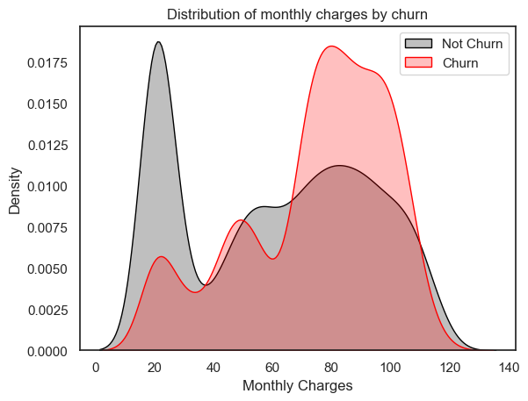
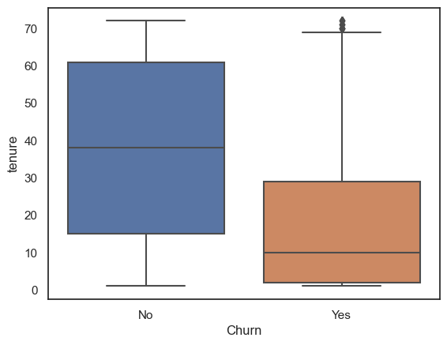
EDA and Data Pre-Processing
Distribution of monthly charges by churn
Churn vs Tenure
Missing values : There are 11 missing values present in “Total Charges”.
Outliers : No outliers were present in the dataset.
Significant variables impacting “Churn”: Type & Tenure of Contract
Churn is observed to be high for customers:
Without dependents
With higher cost of phone services
Having single line service (no combo services)

Slide 5
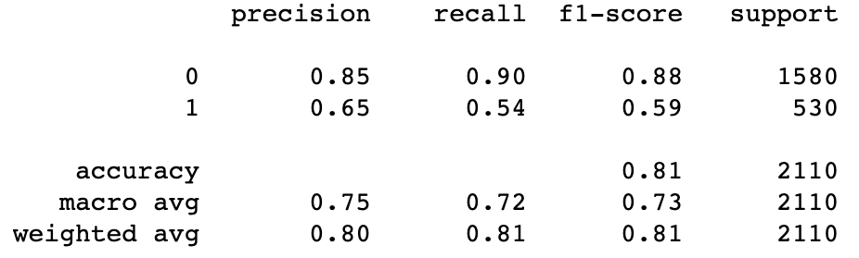
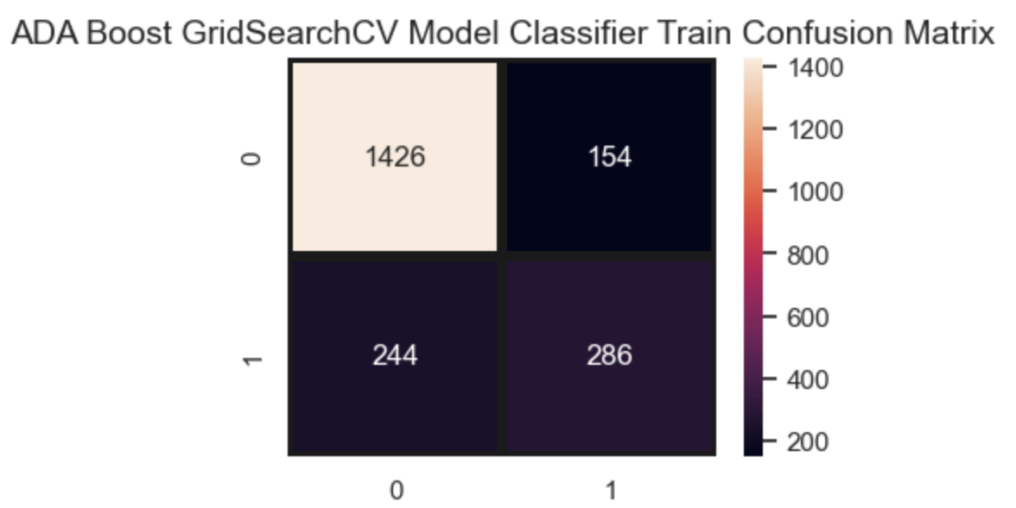
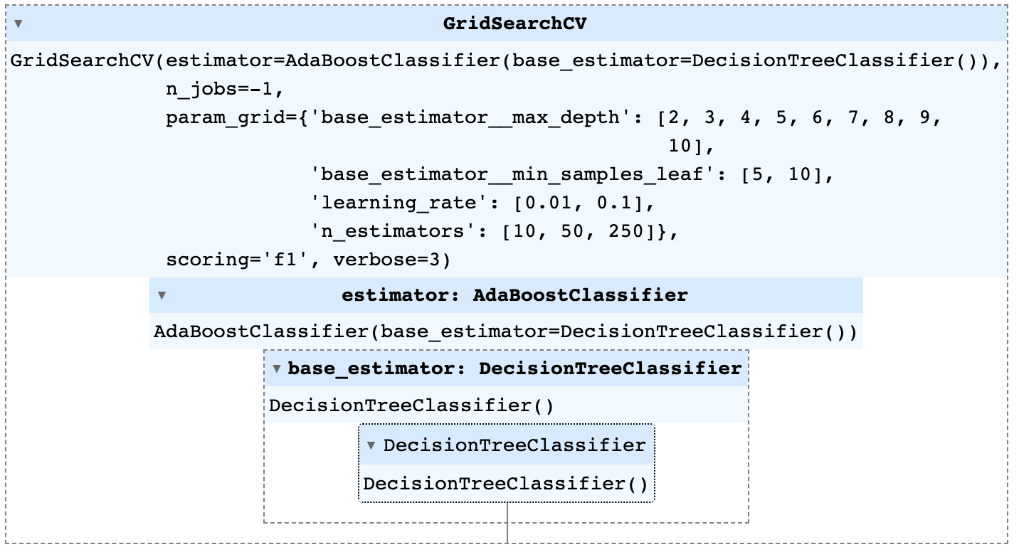
Models Summary
ADABOOST : AdaBoost (Adaptive Boosting) is an ensemble machine learning technique. It works by combining multiple weak learners (models that are just slightly better than random chance) to create a strong learner.. Here we are using Decision Trees as our base model. We have applied GridSearchCV on the base model that is our Decision Tree and also on the Adaboost model. The GridSearchCV is only marginally increasing the accuracy and our final accuracy is 81%

Slide 6
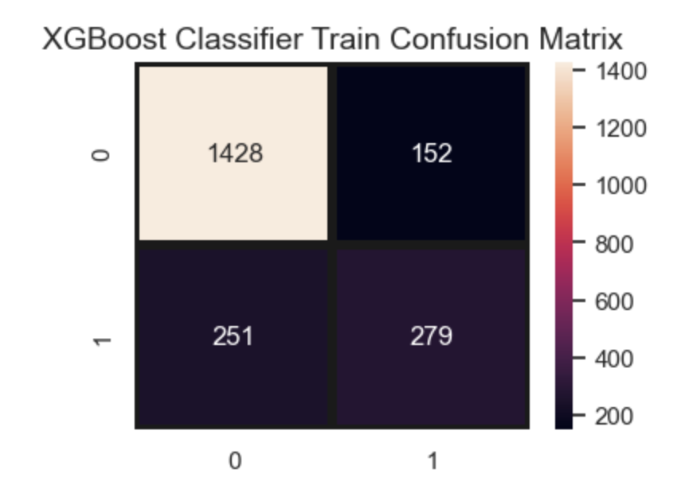
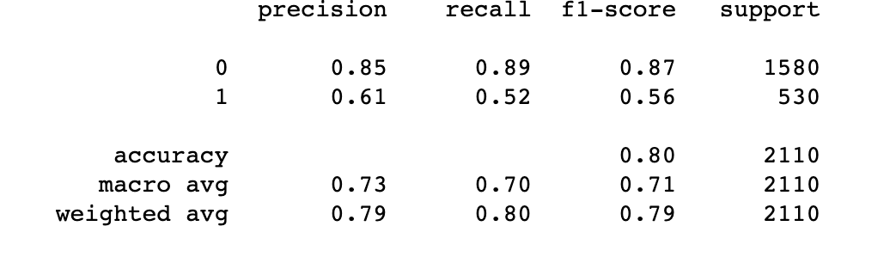
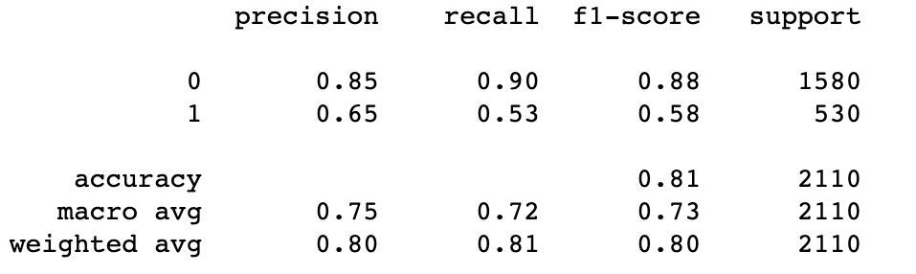
Models Summary
XGBoost : XGBoost is an implementation of gradient boosted decision trees designed for speed and performance. XGBoost approaches the process of sequential tree building using parallelized implementation. We have applied GridSearch CV on colsample_bytree, reg_alpha, reg_lambda and we are getting an accuracy of 81%.
Before GridSearchCV
After GridSearchCV

Slide 7
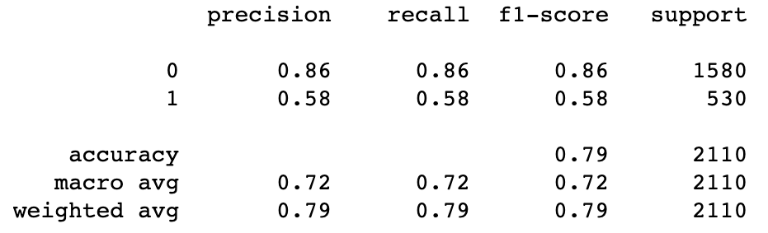
Models Summary
KNN : The k-nearest neighbors algorithm, also known as KNN, is a non-parametric, supervised learning classifier, which uses proximity/distance to make classifications about the grouping of an individual data point. Accuracy : 78.8%
GridSearchCV
Predefined hyperparameters :
Neighbours i.e, K value range from 1 to 101
Weights as 'uniform' and 'distance'
Best parameters :
{'n_neighbors': 65, 'weights': 'uniform'}
Accuracy : 78.9%

Slide 8
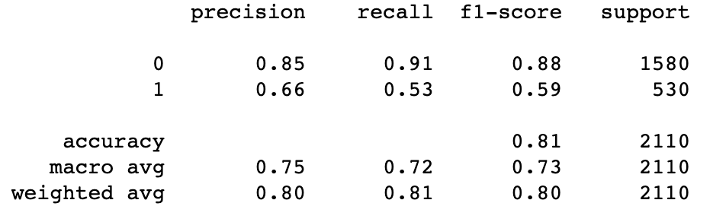
Models Summary
Gradient Boosting Classifier : It is an ensemble machine learning algorithm which combines multiple weak learners to create a strong learner. The optimization is done by gradient descent and hence the name gradient boosting. Accuracy : 80.9%
RandomizedSearchCV
Predefined hyperparameters :
Learning rate and Sub sample as random float
Number of estimators as random integer from 50 to 100
Maximum depth as random integer from 2 to 8
Best parameters :
{'learning_rate': 0.05082669061834777, 'max_depth': 6, 'n_estimators': 55, 'subsample': 0.12911781009653756}
Accuracy : 81.1%

Slide 9
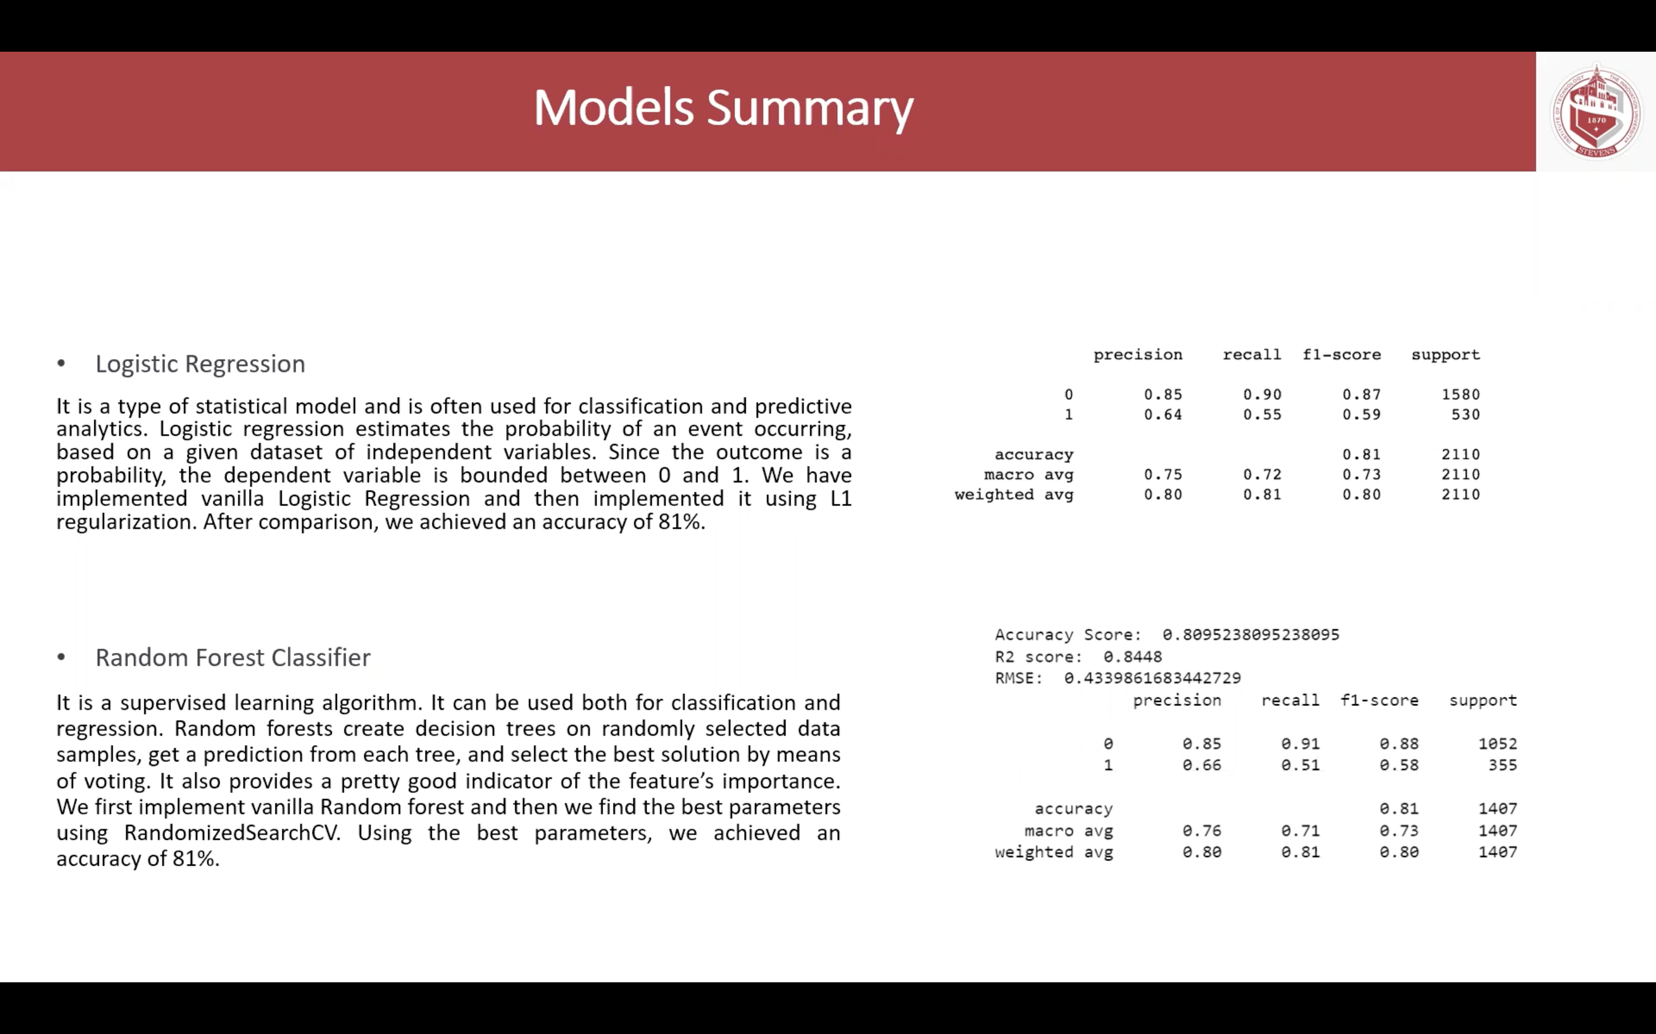

Slide 10
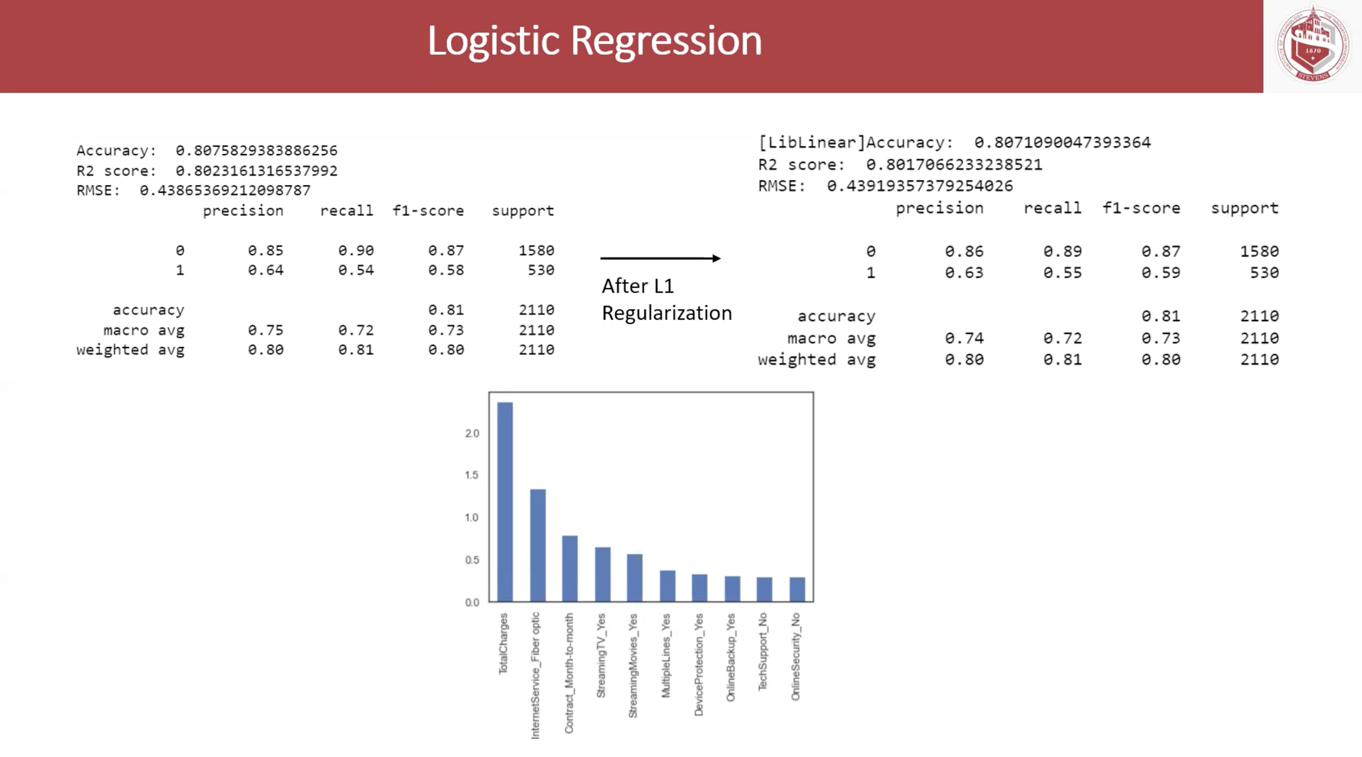

Slide 11
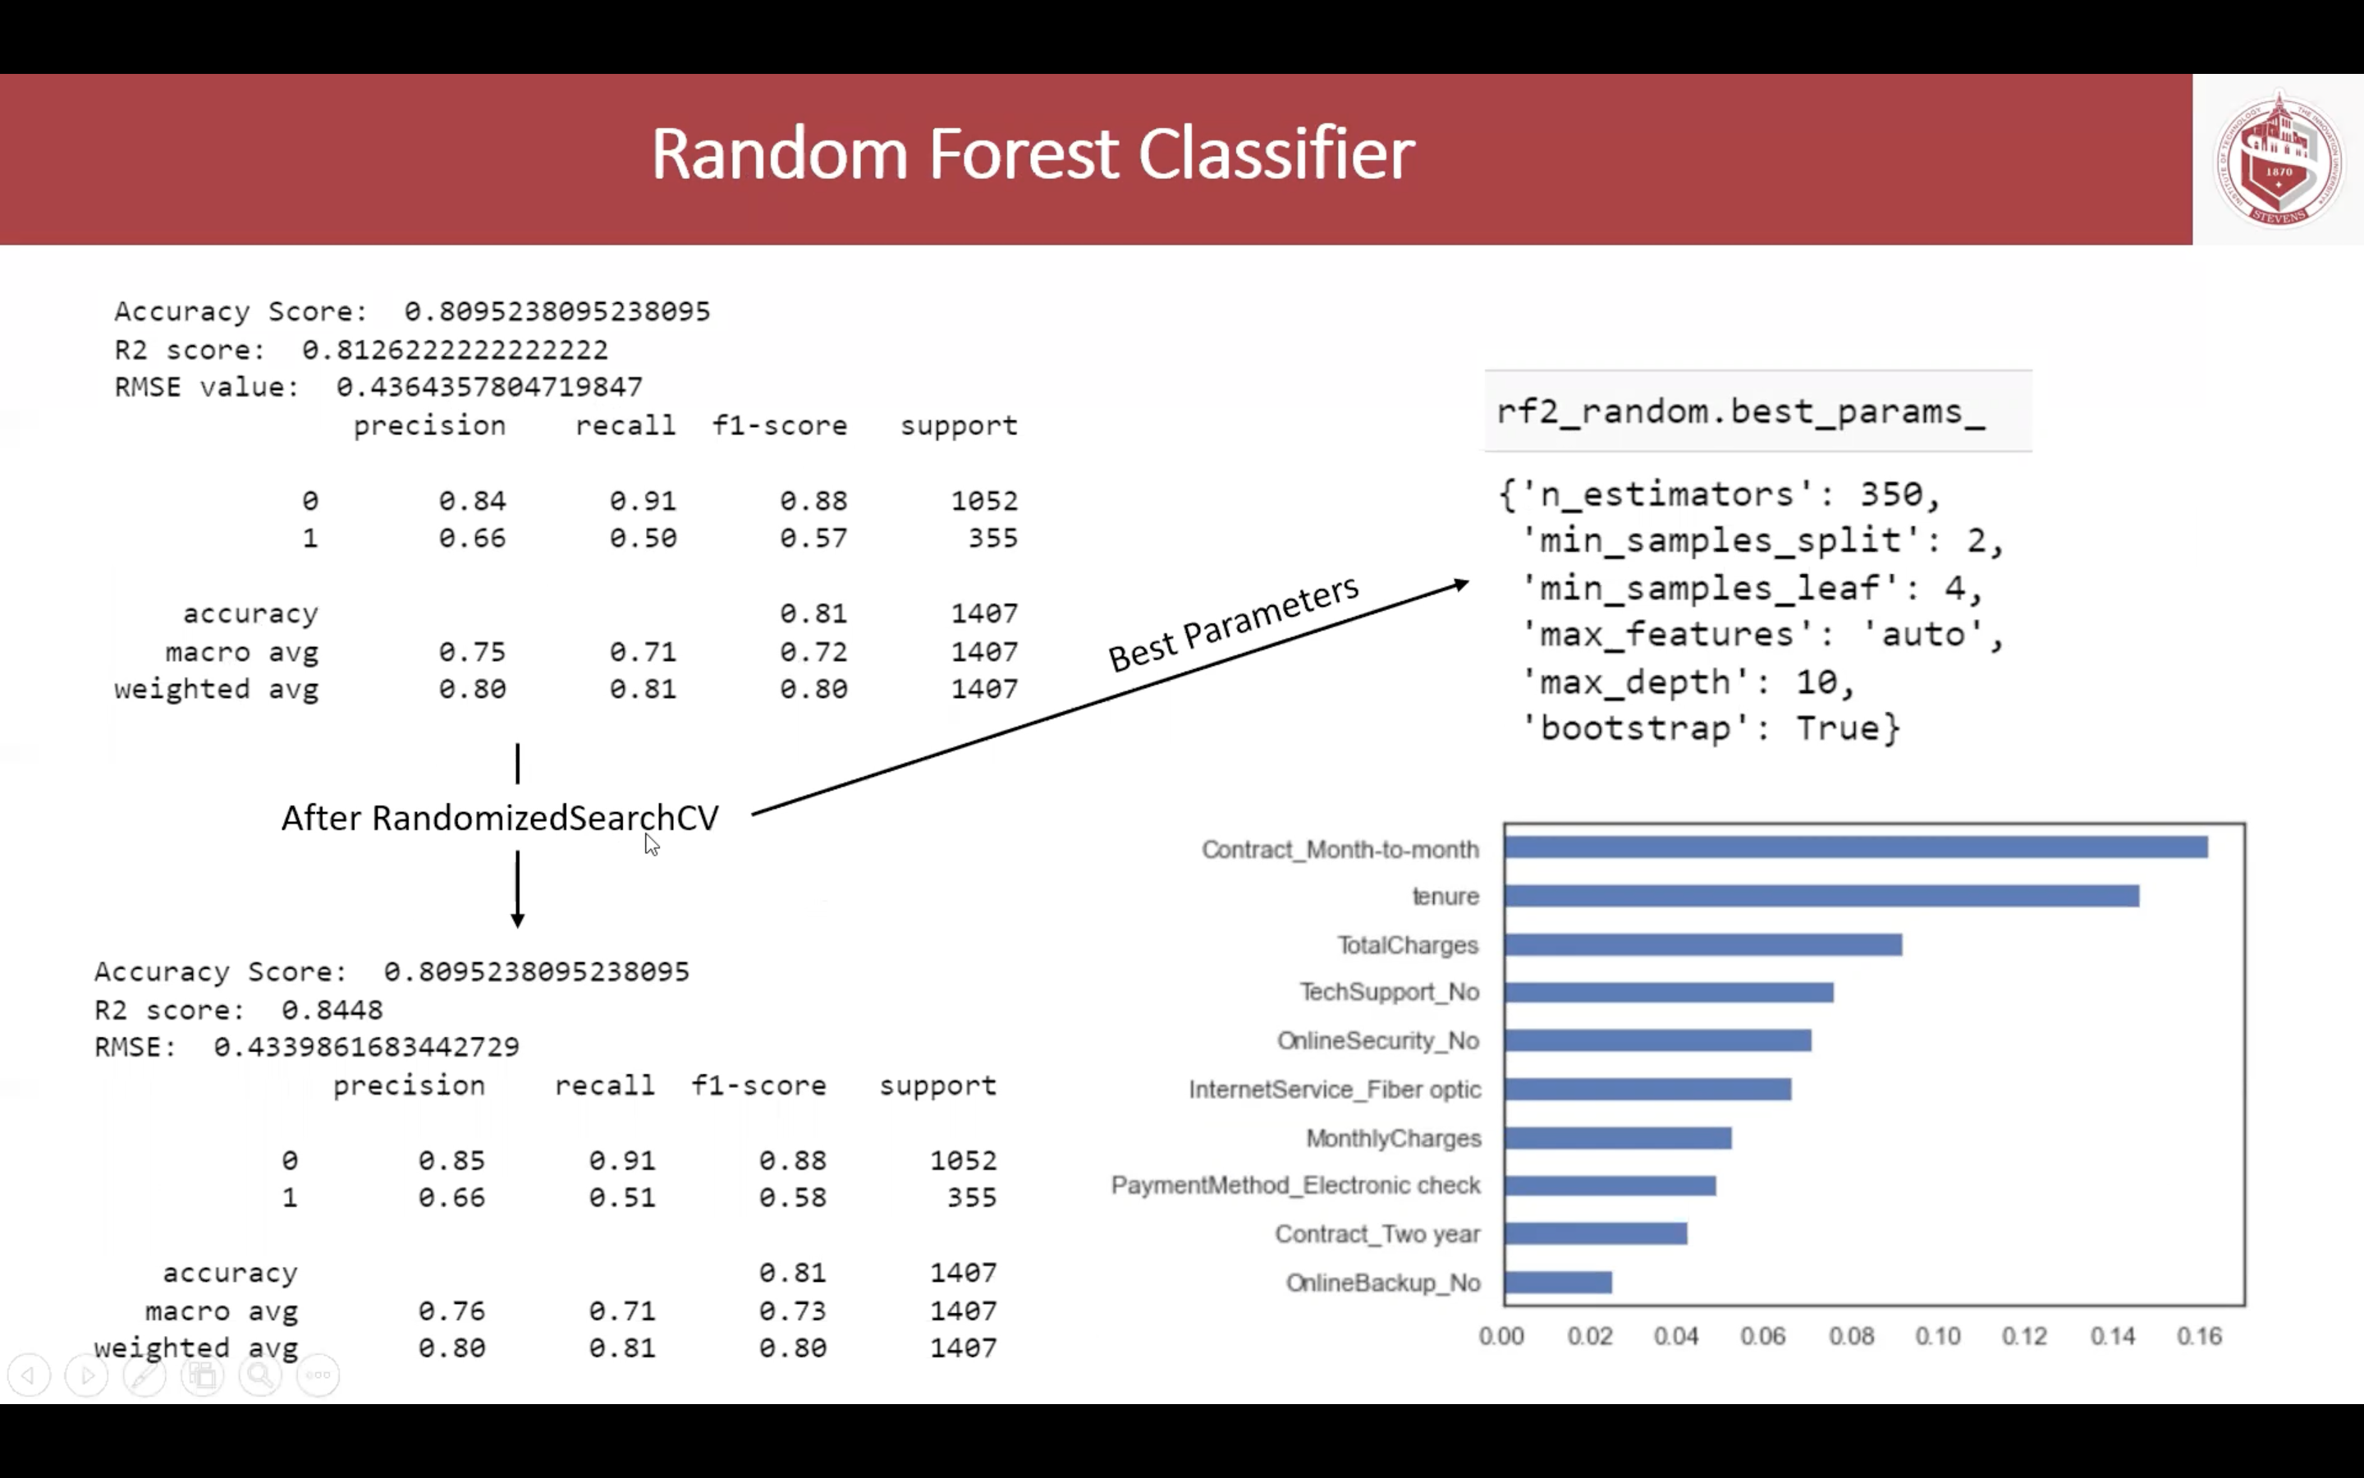

Slide 12
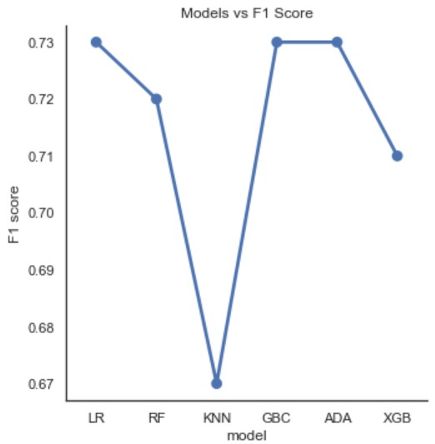
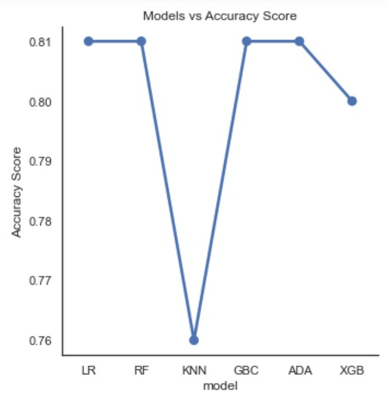
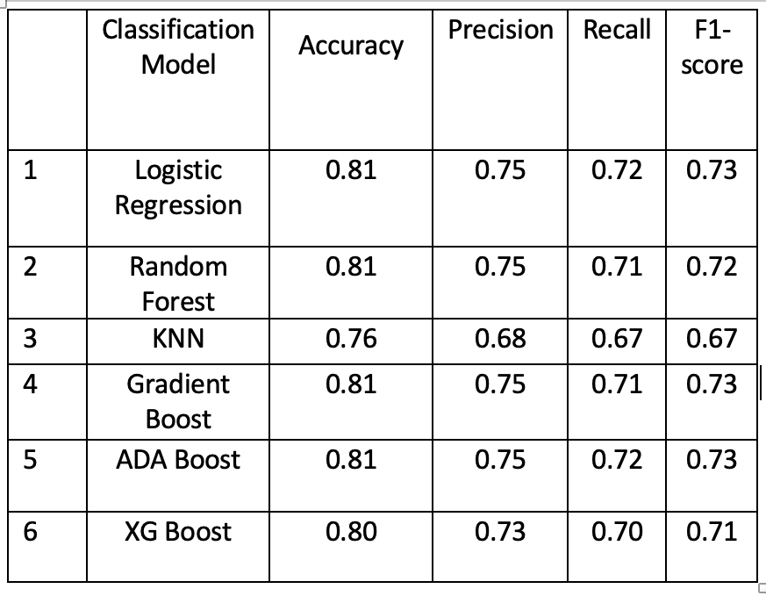
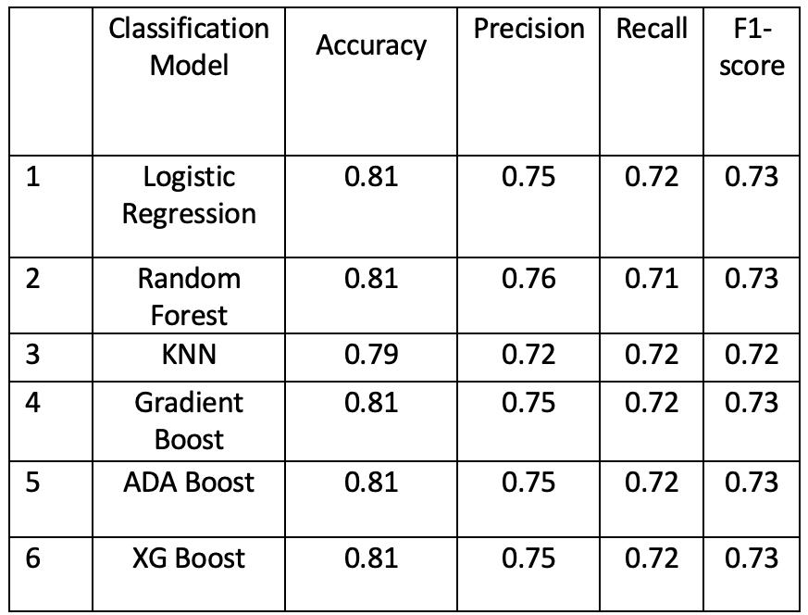
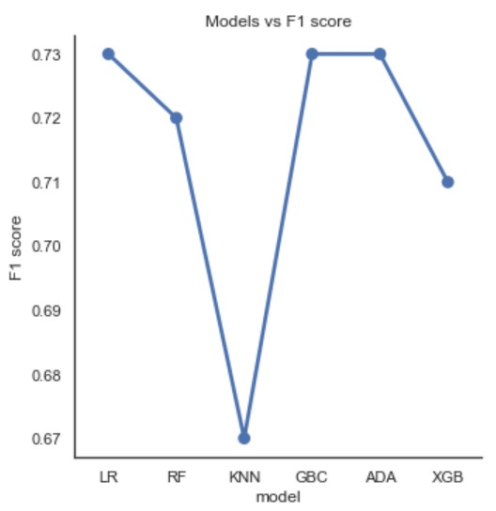
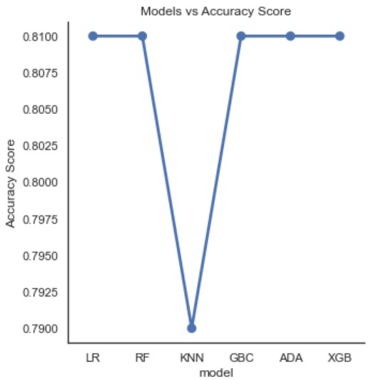
Conclusion and Results
Before tuning
Before tuning
After tuning
For our experiment we found that Random Forest after applying GridSearch CV and getting the optimal parameters gave us the highest accuracy compared to other models by a small margin.
Random Forests is the best model based on :
Highest Accuracy and R2 score
Data driven nature; Easy explainability.
After tuning

